Slide 1

Solutions Overview:
Common Services Framework
Wes Schiel
Senior Architect, SOA/BI CoE
4/25/2007

Slide 2

Copyright Slide
Notes:
Copyright 2006 Sun Microsystems, Inc., 4150 Network Circle, Santa Clara, California, 95054, U.S.A. All rights reserved. This product or document is protected by copyright and distributed under licenses restricting its use, copying, distribution, and decompilation. No part of this product or document may be reproduced in any form by any means without prior written authorization of Sun and its licensors, if any. Third-party software, including font technology, is copyrighted and licensed from Sun suppliers. Sun, Sun Microsystems, the Sun logo, Sun, eGate, eInsight, eVision, eBAM, eXchange, eTL, ePortal, eXpressway, eView, eIndex, and Java are trademarks or registered trademarks of Sun Microsystems, Inc. in the U.S. and other countries. Export Laws. Products, Services, and technical data delivered by Sun may be subject to U.S. export controls or the trade laws of other countries. You will comply with all such laws and obtain all licenses to export, re-export, or import as may be required after delivery to you. You will not export or re-export to entities on the most current U.S. export exclusions lists or to any country subject to U.S. embargo or terrorist controls as specified in the U.S. export laws. You will not use or provide Products, Services, or technical data for nuclear, missile, or chemical biological weaponry end uses.
DOCUMENTATION IS PROVIDED “AS IS” AND ALL EXPRESS OR IMPLIED CONDITIONS, REPRESENTATIONS, AND WARRANTIES, INCLUDING ANY IMPLIED WARRANTY OF MERCHANTABILITY, FITNESS FOR A PARTICULAR PURPOSE OR NON-INFRINGEMENT, ARE DISCLAIMED, EXCEPT TO THE EXTENT THAT SUCH DISCLAIMERS ARE HELD TO BE LEGALLY INVALID. THIS MANUAL IS DESIGNED TO SUPPORT AN INSTRUCTOR-LED TRAINING (ILT) COURSE AND IS INTENDED TO BE USED FOR REFERENCE PURPOSES IN CONJUNCTION WITH THE ILT COURSE. THE MANUAL IS NOT A STANDALONE TRAINING TOOL. USE OF THE MANUAL FOR SELF-STUDY WITHOUT CLASS ATTENDANCE IS NOT RECOMMENDED.
Copyright 2006 Sun Microsystems Inc., 4150 Network Circle, Santa Clara, California, 95054, Etats-Unis. Tous droits réservés. Ce produit ou document est protégé par un copyright et distribué avec des licences qui en restreignent l’utilisation, la copie, la distribution, et la décompilation. Aucune partie de ce produit ou document ne peut être reproduite sous aucune forme, par quelque moyen que ce soit, sans l’autorisation préalable et écrite de Sun et de ses bailleurs de licence, s’il y en a. Le logiciel détenu par des tiers, et qui comprend la technologie relative aux polices de caractères, est protégé par un copyright et licencié par des fournisseurs de Sun. Sun, Sun Microsystems, le logo Sun, Sun, eGate, eInsight, eVision, eBAM, eXchange, eTL, ePortal, eXpressway, eView, eIndex and Java sont des marques de fabrique ou des marques déposées de Sun Microsystems, Inc. aux Etats-Unis et dans d’autres pays. Législation en matière dexportations. Les Produits, Services et données techniques livrés par Sun peuvent être soumis aux contrôles américains sur les exportations, ou à la législation commerciale dautres pays. Nous nous conformerons à lensemble de ces textes et nous obtiendrons toutes licences dexportation, de ré-exportation ou dimportation susceptibles dêtre requises après livraison à Vous. Vous nexporterez, ni ne ré-exporterez en aucun cas à des entités figurant sur les listes américaines dinterdiction dexportation les plus courantes, ni vers un quelconque pays soumis à embargo par les Etats-Unis, ou à des contrôles anti-terroristes, comme prévu par la legislation américaine en matière dexportations. Vous nutiliserez, ni ne fournirez les Produits, Services ou données techniques pour aucune utilization finale liée aux armes nucléaires, chimiques ou biologiques ou aux missiles.
LA DOCUMENTATION EST FOURNIE “EN L’ETAT” ET TOUTES AUTRES CONDITIONS, DECLARATIONS ET GARANTIES EXPRESSES OU TACITES SONT FORMELLEMENT EXCLUES, DANS LA MESURE AUTORISEE PAR LA LOI APPLICABLE, Y COMPRIS NOTAMMENT TOUTE GARANTIE IMPLICITE RELATIVE A LA QUALITE MARCHANDE, A L’APTITUDE A UNE UTILISATION PARTICULIERE OU A L’ABSENCE DE CONTREFAÇON. CE MANUEL DE RÉFÉRENCE DOIT ÊTRE UTILISÉ DANS LE CADRE D’UN COURS DE FORMATION DIRIGÉ PAR UN INSTRUCTEUR (ILT). IL NE S’AGIT PAS D’UN OUTIL DE FORMATION INDÉPENDANT. NOUS VOUS DÉCONSEILLONS DE L’UTILISER DANS LE CADRE D’UNE AUTO-FORMATION.
Please Note: With Sun's recent acquisition of Sun, the Sun Integrated Composite Application Network [JCAPS] product line has been rebranded to Sun Java™ Integration Suite [JIS]. Some course materials may contain the former product names until Sun releases new versions of the course materials. Nevertheless, the training you are about to receive provides the most current information available regarding Sun Java™ Integration Suite.
Version 5.0.5.a

Slide 3
Agenda
History & Overview
Technical Primer
Delivery and Support
Future plans

Slide 4
Origins of the CSF
Consolidating shared functionality from a group of applications into a single shared repository of Common Services is a popular and proven Sun best practice.
Implementation experience teaches us that:
  Most clients build some form of Common Services
  Each implementation is different
  Identifying and leveraging reusable business and technical services is critical to executing a successful SOA strategy
CSF fills a client need for common services
CSF standardizes delivery of common services while providing for customization to meet individual needs
Notes:
Sun has years of experience implementing integration solutions for it’s clients. That experience has proven that many of the services that support integration projects can be consolidated and shared by all of the applications involved. This approach is often referred to as Common Services, and has been one of Sun’s best practices for years. The vast majority of Sun’s clients adopt and embrace this strategy. Unfortunately, every client interprets and implements Common Services differently, which leads to a myriad of disparate, custom solutions. The Common Services Framework provides a standardized delivery for Common Services, which simultaneously fills the client need for CS, while ensuring a quality solution and greatly reducing delivery time.

Slide 5
Introduction
What is CSF?
A JCAPS implementation designed to host Common Services such as error handling, alerting, and logging for multiple applications.
A design based on Service Oriented Architecture (SOA), and proven EAI and J2EE design patterns.
Built on familiar standards like XML, WSDL, JMS, and SOAP.
Fully extensible, allowing services to be easily added or customized.
Based on Sun best practices and development standards.
A hi-performance, scalable, reliable solution.
Notes:
This release of the Common Services Framework is the third iteration of a framework, developed in Sun’s JCAPS 5.0 Suite, for hosting common services. The CSF was built using well-known open standards such as XML, J2EE and following a Service Oriented Architecture approach. The framework is designed to allow infinite addition and customization of services, while still embodying Sun best practices. Finally the CSF is built to be a robust, reliable solution that can scale to handle large message volumes.

Slide 6
CSF Key Features
Flexible, distributed framework for hosting shared services that support integration projects
Centralized management of framework and services
Service isolation and independence
Ubiquitous access to services
Rapidly deployable
Customizable / Extensible
Provides pre-built service implementations for:
  Event Logging
  Error Reporting
  Alert Notifications
  Message Reconciliation
  User Action Audit
Notes:
The focus of the CSF project, as evidenced by the name, is the *framework*. The priority was to build a framework that was robust, flexible, and lent itself well to hosting any number of services of any type. The solution needed to be quick to deploy as well as minimally invasive to existing projects and applications. The services that are provided with the CSF are basic implementations of core services that should fill the needs of many clients out of the box. But the real power of the CSF is the platform on which clients can implement any service that they wish with the minimum time and effort.

Slide 7
Benefits
Technical Benefits
Accelerated deployment
Real-time business visibility
Minimize development cost
Minimize operations cost
Business Benefits
Increased Reusability
Increased Manageability
Reduced Complexity
Standardization

Slide 8
Agenda
History and Overview
Technical Primer
Delivery and Support
Future plans

Slide 9
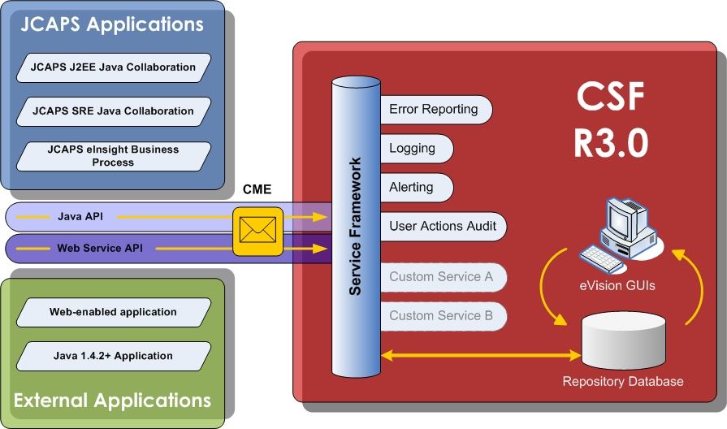
Manager’s View
Notes:
This is an overview of the Components that make up the CSF. Applications, (on the left) can invoke CSF services via one of two protocols: the Java client API or via Web Services. Therefore, any application which uses Java or can call a SOAP web service can utilize any services built on the CSF. All CSF service invocations are transmitted using the CSF canonical message format, the Common Messaging Envelope (CME). The “CSF Repository” is the core of the Framework. The repository is a database which stores all of the configurations for the various services, as well as archives all of the runtime transaction data. The database is accessible for queries or report generation. The CSF includes web-based GUIs for both configuration and runtime data, or [Client] would be free to build their own custom reports to view the data
Within the CSF (right) there are several services that come standard in the package – error handling, alerting, logging, and reconciliation, with the “Custom” services representing the ability to extend the CSF with client-specific services.
.

Slide 10
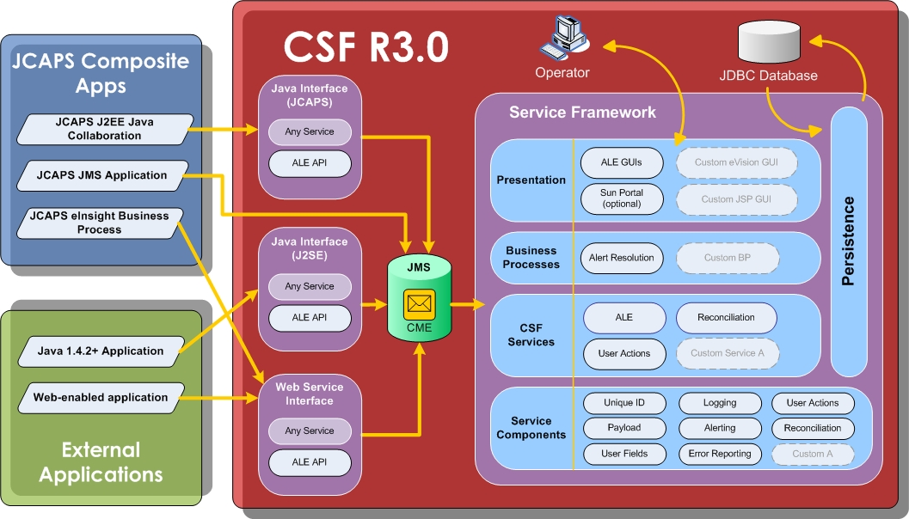
Architect’s View
Notes:
This is an overview of the Components that make up the CSF. Applications, (on the left) can invoke CSF services via one of two protocols: the Java client API or via Web Services. Therefore, any application which uses Java or can call a SOAP web service can utilize any services built on the CSF. All CSF service invocations are transmitted using the CSF canonical message format, the Common Messaging Envelope (CME). The “CSF Repository” is the core of the Framework. The repository is a database which stores all of the configurations for the various services, as well as archives all of the runtime transaction data. The database is accessible for queries or report generation. The CSF includes web-based GUIs for both configuration and runtime data, or [Client] would be free to build their own custom reports to view the data
Within the CSF (right) there are several services that come standard in the package – error handling, alerting, logging, and reconciliation, with the “Custom” services representing the ability to extend the CSF with client-specific services.
.

Slide 11
Enterprise SOA & CSF
Enterprise Applications
B2B Gateway
Notes:
Common Services implemented in CSF are valuable assets; capabilities in these services are critical to executing a successful SOA strategy.
Business Services (Core Application Services) depend on Technical Services, such as OrdersService and CustomersService.
Technical Services are split into four layers:
Transformation Services – Implemented within Application
Interface Services – Implemented within Application
Common Services – Implemented in Common Services Framework (common system services, such as logging, alerting, metering, etc.)
Infrastructure Services – Part of JCAPS Product (messaging, database access services, and so on)
Note that Common Services can be called directly by any other layer.

Slide 12
Design of CSF – Repository
  Rapid configuration via parameter driven configuration
  Centralized management through configuration tables
  Runtime visibility through runtime tables
Stores Configuration and Runtime Data
Enables on-the-fly configuration changes
Supports various JDBC compliant databases
Easy access through eVision-based GUIs
Accessible through 3rd party tools (SQL*Plus, TOAD, Crystal Reports)
Efficient schema design ensures performance and stability
Notes:
The CSF repository database (not to be confused with the JCAPS repository) is the core of the Common Services Framework. The repository is a JDBC compliant database which stores all of the configurations for the various services, as well as archives all of the runtime transaction data. Currently, we have tested CSF R3 with Oracle 8-10, DB2, MS SQL Server.
Configuration information includes logging, error handling, and alerting codes; alert email addresses and groups; log file path and filename; severity levels; etc…
Runtime data includes message ID, source application, timestamp, transaction label, message details, payload, etc…
Configuration changes can be made in real time without any need to bring services down to make the changes. This can be done by editing the database tables directly or by using the eVision GUIs provided in the CSF package.
The database is accessible for queries or report generation. The CSF includes web-based GUIs built in eVision for both configuration and runtime data. Alternately, [Client] would be free to create their own custom reports and interfaces to view/edit the data.
Supports various JDBC compliant databases: Oracle 8 & 9i, DB 2, SQL Server 2000

Slide 13
Design of CSF – GUI
CSF GUI provides Web based access to event and configuration data for all Common Services
Simplified service configuration
Aggregated view of CSF events for Operations Team
Secure access based on roles, groups, and permissions
Implemented in eVision, easily customizable
Modular design: stand-alone GUIs can be unified using a portal

Slide 14
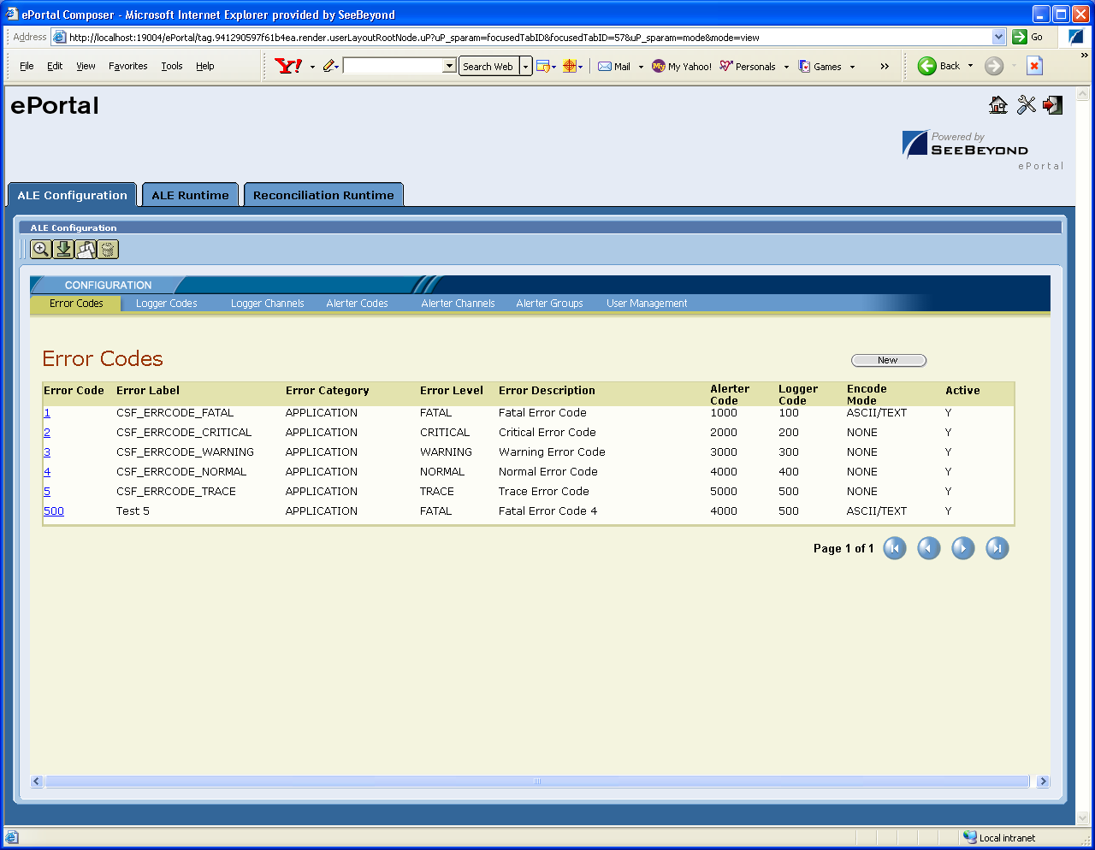
Design of CSF – GUI
ALE Configuration
Notes:
Clicking on the error code brings up a Detail view of an error code, which can be edited and saved.

Slide 15
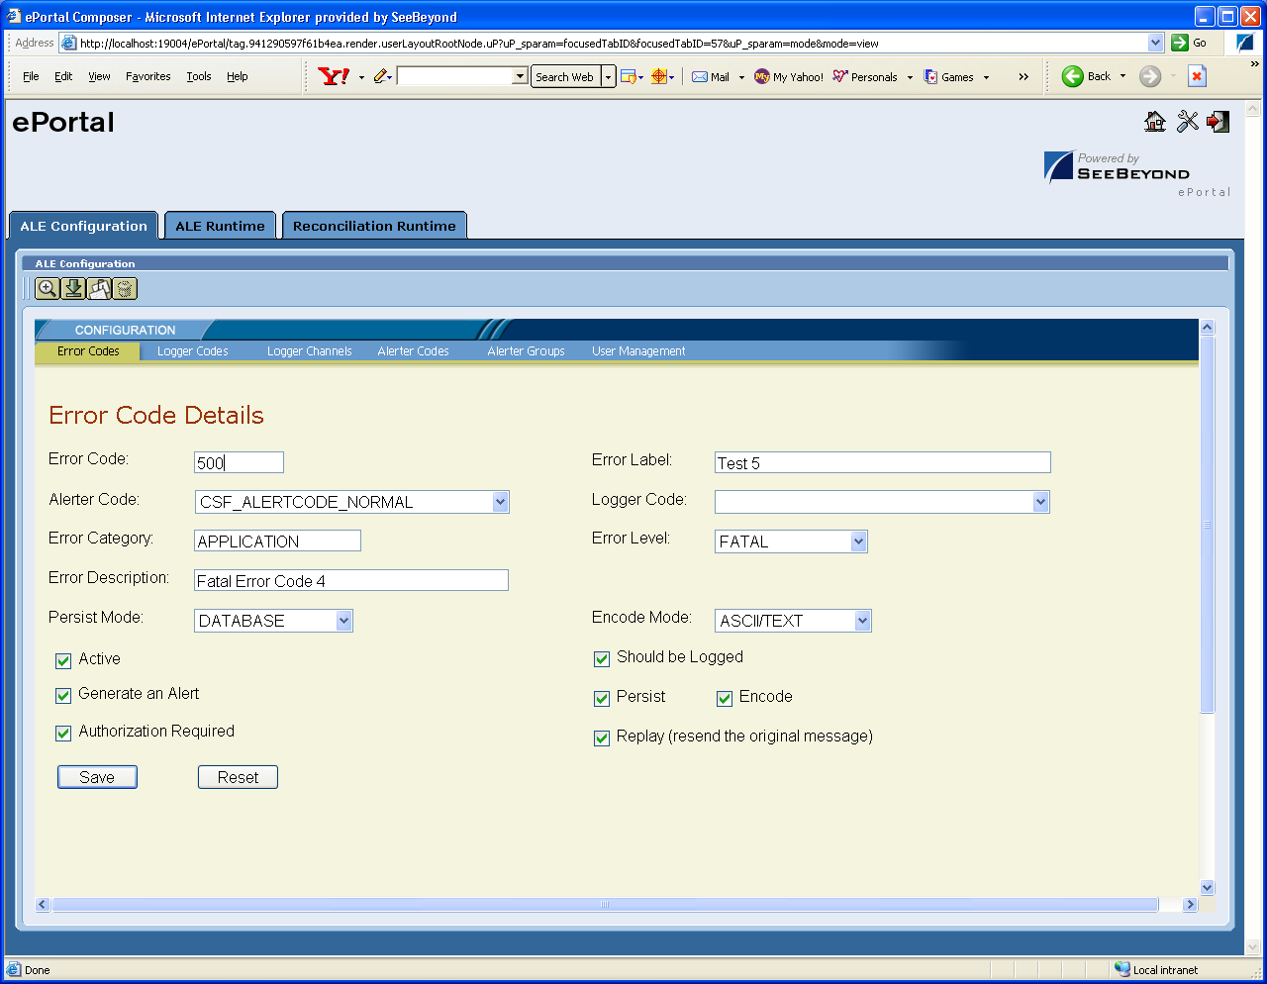
Design of CSF – GUI
ALE Configuration
Notes:
Clicking on the error code brings up a Detail view of an error code, which can be edited and saved.

Slide 16
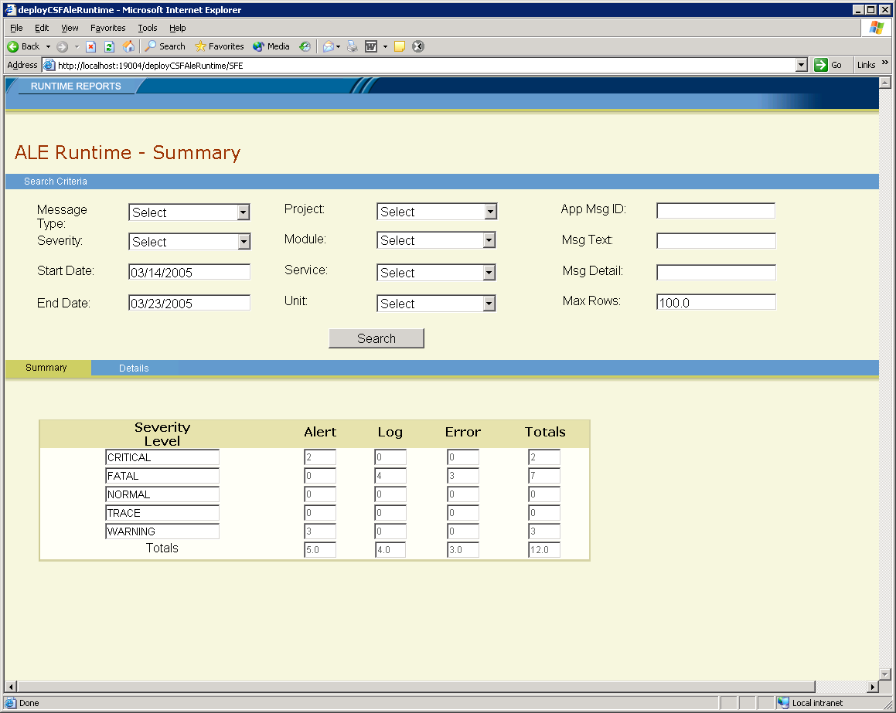
Design of CSF – GUI
ALE Runtime
Query Summary

Slide 17
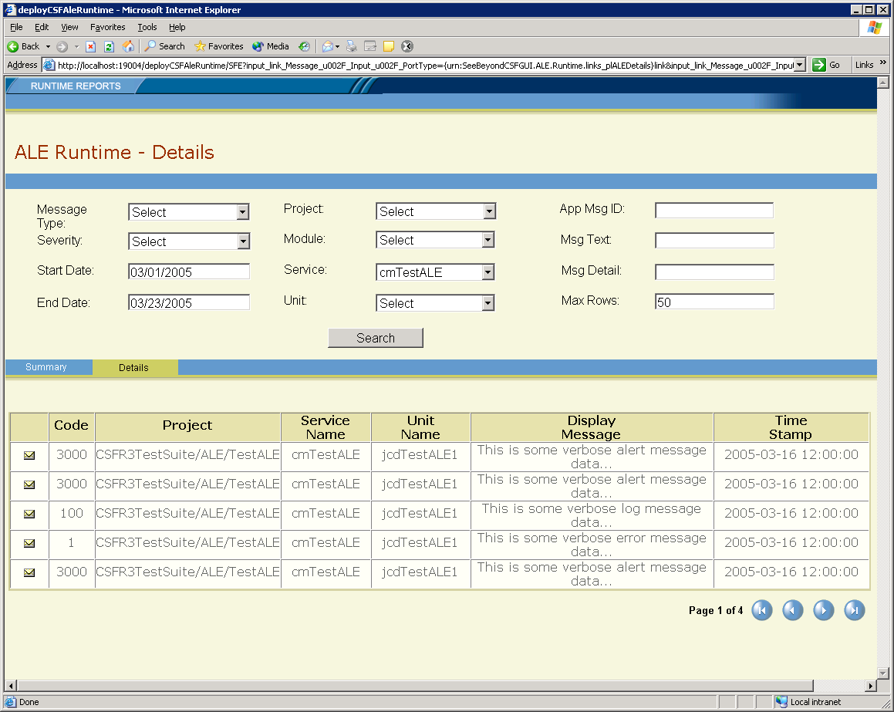
Design of CSF – GUI
ALE Runtime
Query Details

Slide 18
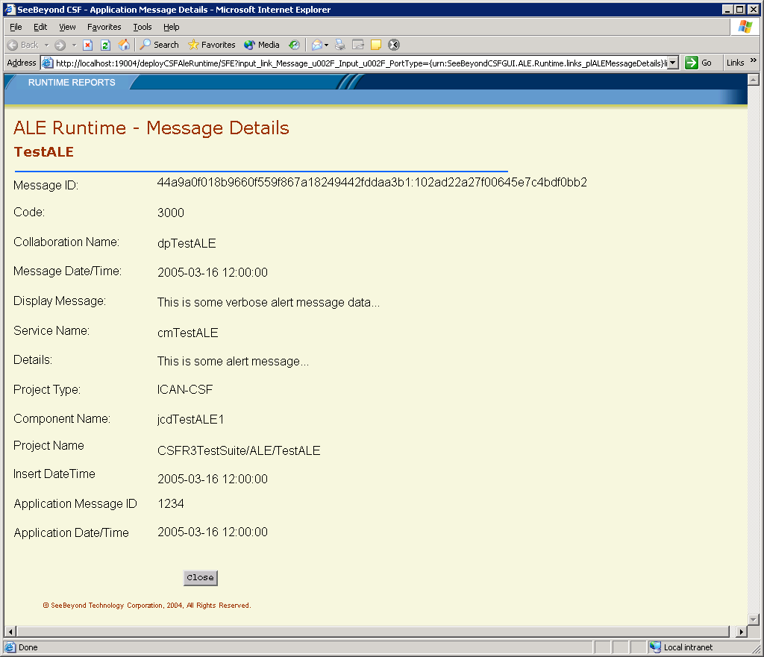
Design of CSF – GUI
ALE Runtime
Message Details

Slide 19
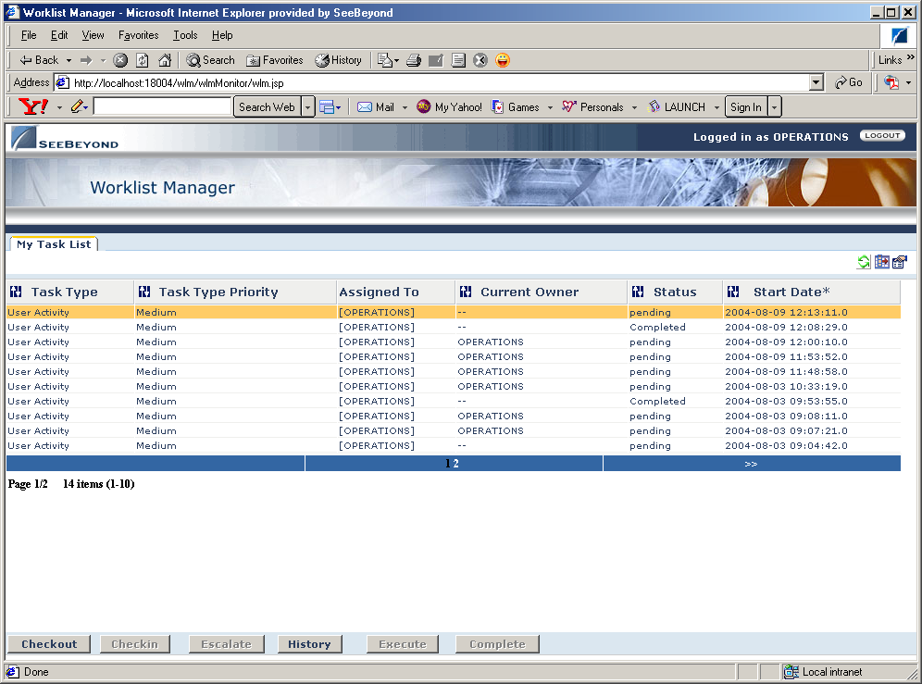
Design of CSF – GUI
Alert Resolution
Alert Resolution WLM

Slide 20
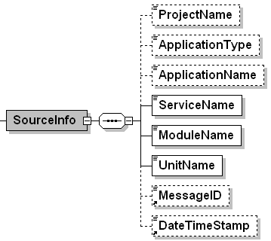
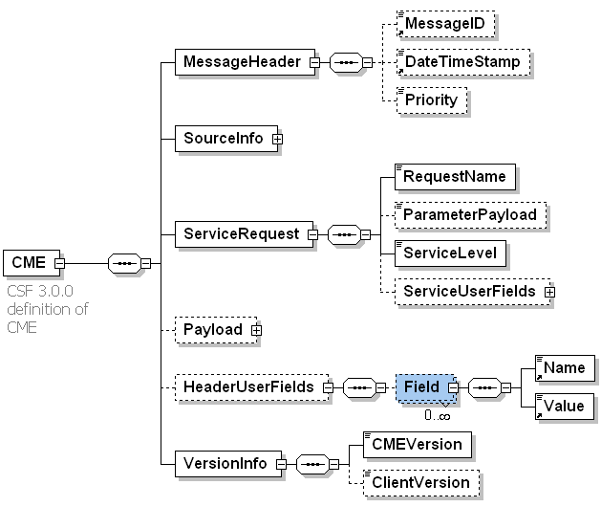
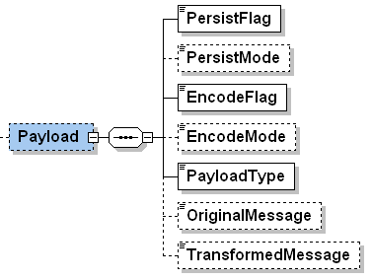
Design of CSF – CME
Structure Overview
Includes source system info
Priority drives JMS
Generic format for all CSF Services
Dynamic customization via User Fields
Supports versioning
Payload supports encoding

Slide 21
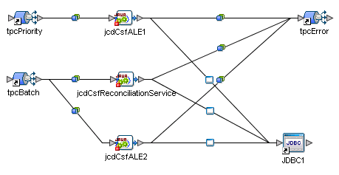
Design of CSF – Server Side
Architected for service isolation and independence
Generic service framework facilitates new service development
JMS topics are the entry points into CSF
Separate channels for priority and batch messages
Topic names and locations set in java properties file
Error topic captures CSF processing errors
JDBC DB eWay used for vendor-neutral DB connection
Notes:
This is the JCAPS connectivity map for the main CSF project. This is where the incoming CME messages are processed and the repository database is updated. There are two JMS entry points, one for batch (non-critical) messages, and a second for near-real-time priority messages. The JMS topic names and associated message priorities (??? – check this) are referenced from a java properties file that is included in the JCAPS project. The services themselves are written completely in Java and are represented by the JCDs on the connectivity map.

Slide 22
Design of CSF – Client Side
CSF
R3.0
Web
Application
WS API
Java API
Java
Application
Web Service Interface
Java Interface
Interfaces provide generic access to any CSF service
Convenience API acts as façade for an Interface
APIs provide convenient service-specific access with less code
APIs are optional and separately deployable
Notes:
Self-explanatory

Slide 23
Design of CSF – Client Side
Java Interface
Java Interface: Generic
  Include client JAR file in CLASSPATH
  Initialize the csfClient
  Load hashmap with service data
  Send the service request
  Example:
csfClient.initialize();
HashMap params = new HashMap();
params.put( "LogUseFlag", "Y" );
params.put( "LogCode", "200" );
CSFRequest req = csfClient.send("ALE", params, payload, “BATCH” );
Notes:
Invoking CSF services from a java application requires minimal coding. A jar file must be included that contains the CSFClient class. Then a client abject is instantiated and initialized. If no service-specific API was written for the service, then a hash-map containing the service specific data is populated and the service request is made using this hash-map. However, this is not necessary for services that come with the CSF (see next slide).

Slide 24
Design of CSF – Client Side
Java Client
Java API: Service-specific
  Include client & API JAR files in CLASSPATH
  Create Service API object
  Make Service API calls
  Example:
csfClient.initialize();
CSFALEConv aleAPI = new CSFALEConv(csfClient);
aleAPI.sendLog(“200”, “Process A Completed Successfully”)
This example sends a simple log message
Less code
Easier to read and understand
Notes:
Developers have the option (and it is recommended that they take advantage of it) to create service-specific API that can be used to invoke the services. This means that services can be called with less code and more descriptive method names. All of the core services included with CSF have service-specific APIs already written for them.
A jar file must be included that contains the CSFClient class. Then a client abject is instantiated and initialized, and the desired service is called. The API contains multiple versions of all the service calls which can accept only minimal data (as shown above) or as much detail as desired.

Slide 25
Design of CSF – Services
Core Services Included with CSF:
  ALE (Alerting, Logging, and Error Reporting)
  Reconciliation
  User Actions Audit
Support Services Included with CSF:
  Unique ID Service
  Payload Service
  User Fields Service
All services record runtime events in the CSF Repository
ALE provides opportunity for standardization of codes and severity levels across the enterprise
Alert service delivers critical event notifications via eMail
UAA provides audit trail of user interaction with an application
Message payload can be Base64 encoded for any service
CSF message data can be dynamically customized with User Fields
Notes:
As I mentioned previously, there are several services that come pre-built. There are 8 services in all:
Top-level services:
Error Handling (ALE): Logs errors to the repository. Can be configured to automatically generate log messages and/or send alerts.
Logging (ALE): Logs informational messages to the repository or to text files.
Alerting (ALE): Logs alert transaction to the repository and generates email notifications
Reconciliation: Provides message reconciliation, which keeps track of which transactions were completed successfully
Implementation services:
Payload: Archives message payload. Can be done both pre and post transformation. Can be encoded in Base64 or ASCII.
Unique ID: Creates a unique alphanumeric string which is guaranteed unique even when there are multiple CSF implementations across multiple physical and logical hosts. Used to ID CSF messages.
System Info: Stores information about the systems that invoke CSF services
DBTypeService
CMEService
User Fields: Name-value pairs that are stored to the repository and associated with a message ID. Allows users to add custom to the CME messages.
Future plans - Incrementally build new services:
Replay Service
Quality of Service Alerter Service
Replay Robots
Metering Service
GEOD Service
Others

Slide 26
Agenda
History and Overview
Technical Primer
Delivery and Support
Future plans

Slide 27





Sun – CSF R3 Package Contents
Installation Package
Common Services Framework Components
Repository Scripts and Sample data
eVision Web-based Graphical User Interfaces
Deployment Guides
Installation Guide
User Guide
Developer Guide
Sun Professional Services
Installation and execution of a sample project
Training
Implementation guidance
Notes:
The Common services framework is delivered as package that contains:
Contact point is Geoff Brimm for CSF Package
Installation package includes:
JCAPS CSF Project and sample client projects
Java API libraries and source code
Database build scripts with sample data for both Oracle 8i and 9i
Graphical User Interfaces (built in eVision)
The components an services of the CSF are fully documented in a series of documents provided with the package:
Install guide
User Guide
Architecture and design document
Naming conventions
The CSF is delivered in combination with Sun Professional Services. Sun consultants will assist in the installation and configuration of the CSF, as well as provide design and implementation assistance for additional services or enhancements to existing ones.

Slide 28
Deploying CSF
Run CSF Installer to extract package contents
Create Database instance for Repository and build tables with the included scripts
Import JCAPS projects
Create JCAPS environment
Deploy projects
Run included test projects to verify installation
Begin incorporating CSF client code in the applications that will leverage CSF services
Notes:
The focus of the CSF project, as evidenced by the name, is the *framework*. The priority was to build a framework that was robust, flexible, and lent itself well to hosting any number of services of any type. The solution needed to be quick to deploy as well as minimally invasive to existing projects and applications. The services that are provided with the CSF are basic implementations of core services that should fill the needs of many clients out of the box. But the real power of the CSF is the platform on which clients can implement any service that they wish with the minimum time and effort.

Slide 29
Support and Training
Technical Support
  Supported via Professional Services
  ProServ resources can leverage normal product support channels via the web, phone, or email
  Escalated incidents will go to the CoE Solutions queue
Internal Support
  CSF Knowledge Center (wiki) https://onestopwiki.sfbay.sun.com/index.php?title=Common_Services_Framework_%28CSF%29
    Access to the latest documentation
    List of known issues and updates
    Field enhancements
Solutions Training
  2-Day training of CSF targeted at users and framework developers
  CAPS 710 is currently delivered by Professional Services

Slide 30
Agenda
History and Overview
Technical Primer
Delivery and Support
Future plans

Slide 31
Future Plans
Current release
  CSF 3.0.8d
  Released 4/18/2007
  Certified on Java CAPS 5.1.2
  Testing underway on 5.1.3
CSF 4.0
  Currently on hold
  CAPS 5.1.3
  Tighter alignment with SOA principles
  Enhanced versions of Core services
  Simpler service customization and development
  Message Replay service

Slide 32
Thanks for your time and attention
Q&A
Notes:
Copyright 2006 Sun Microsystems, Inc., 4150 Network Circle, Santa Clara, California, 95054, U.S.A. All rights reserved. This product or document is protected by copyright and distributed under licenses restricting its use, copying, distribution, and decompilation. No part of this product or document may be reproduced in any form by any means without prior written authorization of Sun and its licensors, if any. Third-party software, including font technology, is copyrighted and licensed from Sun suppliers. Sun, Sun Microsystems, the Sun logo, Sun, eGate, eInsight, eVision, eBAM, eXchange, eTL, ePortal, eXpressway, eView, eIndex, and Java are trademarks or registered trademarks of Sun Microsystems, Inc. in the U.S. and other countries. Export Laws. Products, Services, and technical data delivered by Sun may be subject to U.S. export controls or the trade laws of other countries. You will comply with all such laws and obtain all licenses to export, re-export, or import as may be required after delivery to you. You will not export or re-export to entities on the most current U.S. export exclusions lists or to any country subject to U.S. embargo or terrorist controls as specified in the U.S. export laws. You will not use or provide Products, Services, or technical data for nuclear, missile, or chemical biological weaponry end uses.
DOCUMENTATION IS PROVIDED “AS IS” AND ALL EXPRESS OR IMPLIED CONDITIONS, REPRESENTATIONS, AND WARRANTIES, INCLUDING ANY IMPLIED WARRANTY OF MERCHANTABILITY, FITNESS FOR A PARTICULAR PURPOSE OR NON-INFRINGEMENT, ARE DISCLAIMED, EXCEPT TO THE EXTENT THAT SUCH DISCLAIMERS ARE HELD TO BE LEGALLY INVALID. THIS MANUAL IS DESIGNED TO SUPPORT AN INSTRUCTOR-LED TRAINING (ILT) COURSE AND IS INTENDED TO BE USED FOR REFERENCE PURPOSES IN CONJUNCTION WITH THE ILT COURSE. THE MANUAL IS NOT A STANDALONE TRAINING TOOL. USE OF THE MANUAL FOR SELF-STUDY WITHOUT CLASS ATTENDANCE IS NOT RECOMMENDED.
Copyright 2006 Sun Microsystems Inc., 4150 Network Circle, Santa Clara, California, 95054, Etats-Unis. Tous droits réservés. Ce produit ou document est protégé par un copyright et distribué avec des licences qui en restreignent l’utilisation, la copie, la distribution, et la décompilation. Aucune partie de ce produit ou document ne peut être reproduite sous aucune forme, par quelque moyen que ce soit, sans l’autorisation préalable et écrite de Sun et de ses bailleurs de licence, s’il y en a. Le logiciel détenu par des tiers, et qui comprend la technologie relative aux polices de caractères, est protégé par un copyright et licencié par des fournisseurs de Sun. Sun, Sun Microsystems, le logo Sun, Sun, eGate, eInsight, eVision, eBAM, eXchange, eTL, ePortal, eXpressway, eView, eIndex and Java sont des marques de fabrique ou des marques déposées de Sun Microsystems, Inc. aux Etats-Unis et dans d’autres pays. Législation en matière dexportations. Les Produits, Services et données techniques livrés par Sun peuvent être soumis aux contrôles américains sur les exportations, ou à la législation commerciale dautres pays. Nous nous conformerons à lensemble de ces textes et nous obtiendrons toutes licences dexportation, de ré-exportation ou dimportation susceptibles dêtre requises après livraison à Vous. Vous nexporterez, ni ne ré-exporterez en aucun cas à des entités figurant sur les listes américaines dinterdiction dexportation les plus courantes, ni vers un quelconque pays soumis à embargo par les Etats-Unis, ou à des contrôles anti-terroristes, comme prévu par la legislation américaine en matière dexportations. Vous nutiliserez, ni ne fournirez les Produits, Services ou données techniques pour aucune utilization finale liée aux armes nucléaires, chimiques ou biologiques ou aux missiles.
LA DOCUMENTATION EST FOURNIE “EN L’ETAT” ET TOUTES AUTRES CONDITIONS, DECLARATIONS ET GARANTIES EXPRESSES OU TACITES SONT FORMELLEMENT EXCLUES, DANS LA MESURE AUTORISEE PAR LA LOI APPLICABLE, Y COMPRIS NOTAMMENT TOUTE GARANTIE IMPLICITE RELATIVE A LA QUALITE MARCHANDE, A L’APTITUDE A UNE UTILISATION PARTICULIERE OU A L’ABSENCE DE CONTREFAÇON. CE MANUEL DE RÉFÉRENCE DOIT ÊTRE UTILISÉ DANS LE CADRE D’UN COURS DE FORMATION DIRIGÉ PAR UN INSTRUCTEUR (ILT). IL NE S’AGIT PAS D’UN OUTIL DE FORMATION INDÉPENDANT. NOUS VOUS DÉCONSEILLONS DE L’UTILISER DANS LE CADRE D’UNE AUTO-FORMATION.
Please Note: With Sun's recent acquisition of Sun, the Sun Integrated Composite Application Network [JCAPS] product line has been rebranded to Sun Java™ Integration Suite [JIS]. Some course materials may contain the former product names until Sun releases new versions of the course materials. Nevertheless, the training you are about to receive provides the most current information available regarding Sun Java™ Integration Suite.
Version 5.0.5.a

